Slide 1
Impact of COVID-19 to
Post Trends and Engagements within Mental Health-related Subreddits
Hanna Song, Anh Nguyen

Slide 2
Introduction to Research
Research Question
Does COVID impact post trends and engagements within mental health-related subreddits?
Hypothesis
Mental health-related subreddits will exhibit a shift in post trends as well as the number of engagements – such as post text, number of comments, score and upvoted ratios – between the pre-COVID and post-COVID periods.

Slide 3
Importance of Relationship
Understanding the impact of COVID-19 on mental health
Monitoring community well-being online
Informing public health intervention
Research and academic purposes
Further research on socio-economic circumstances, overall happiness index

Slide 4
Overview of Research Process
01
02
03
04
05
06
Data Collection
Data Preprocessing
General EDA
Text Classification
Time Series Analysis
Conclusions

Slide 5

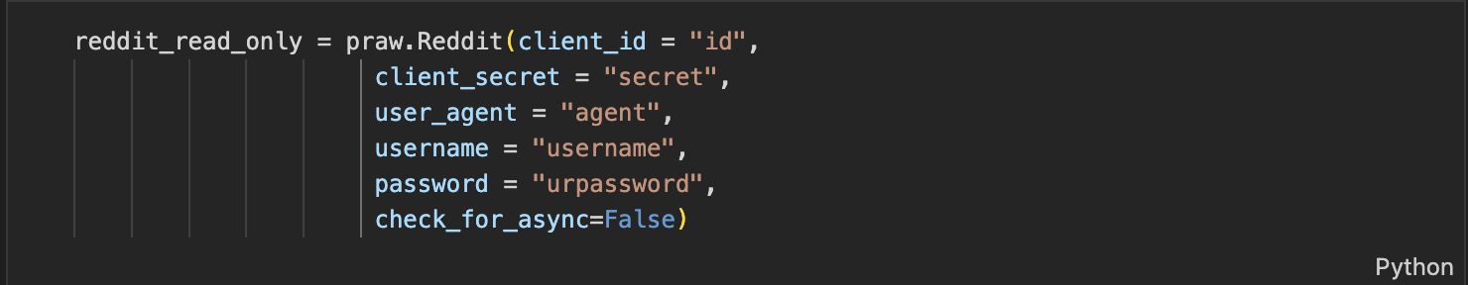
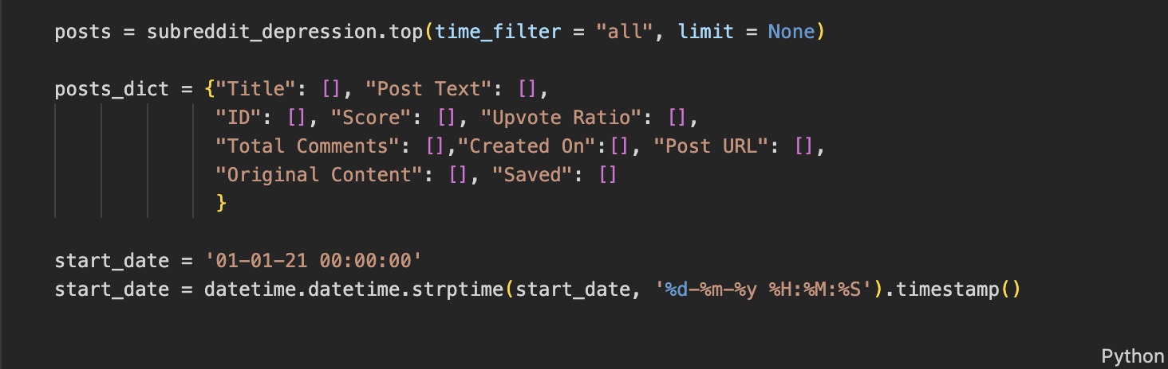
ETL - Data Collection
Reddit API
Timeframe:
2018 - Jan 2020
Feb 2020 - 2023
Monthly top posts on mental health-related subreddits
Legal as long as we respect regulations such as GDPR and CCPA

Slide 6
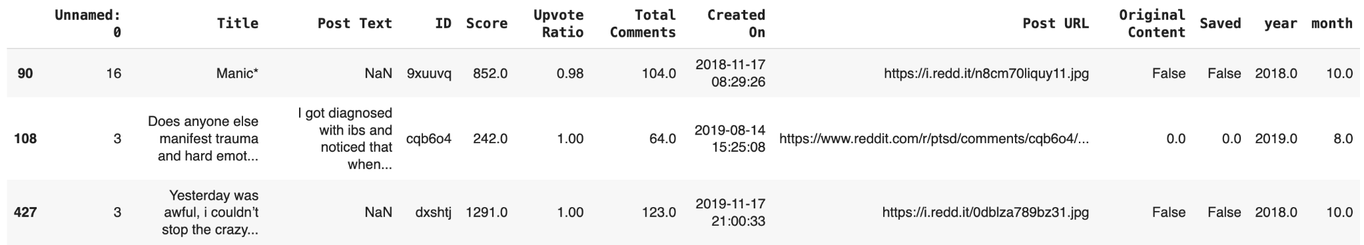
Sample Data
(Depression subreddit)
Subreddits : Depression, Anxiety, ADHD, Bipolar, PTSD, Schizophrenia,
Eating Disorders, Brain Fog, Suicide Watch

Slide 7
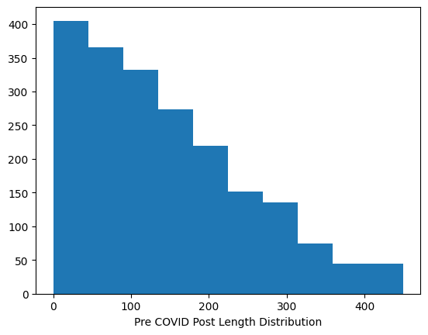
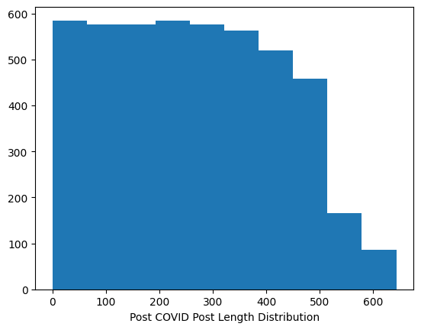
Post Length Histogram:
Pre-COVID vs Post-COVID

Slide 8
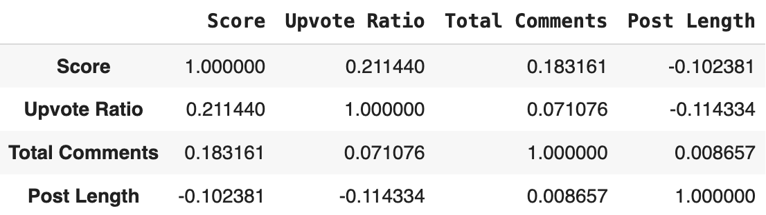
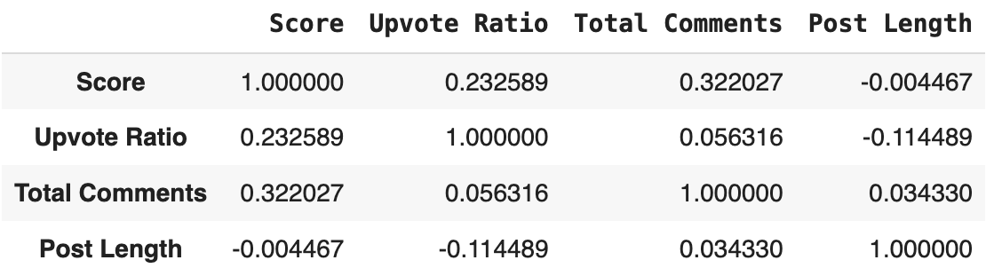
Log Transformation
Pearson’s
Pre-COVID
Post-COVID

Slide 9
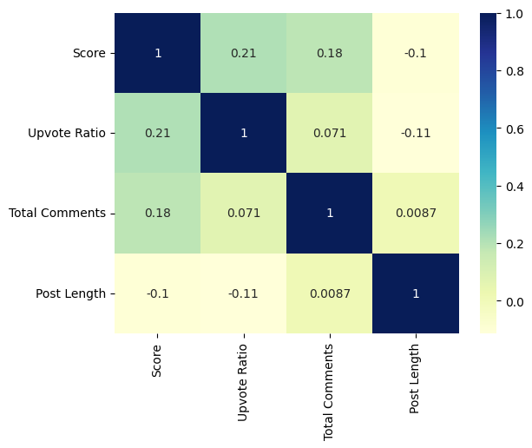
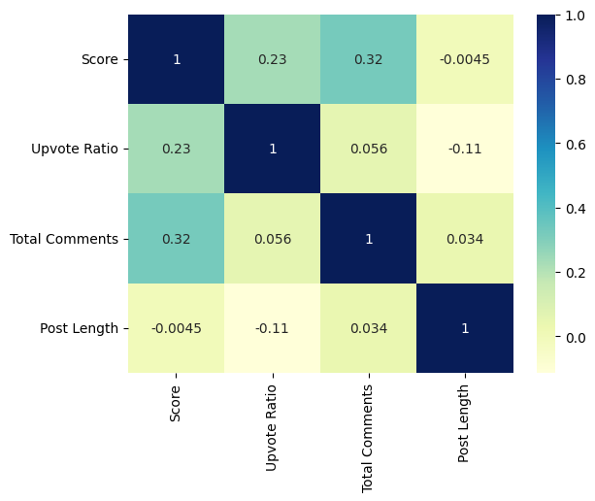
Correlation Matrix
Pre-COVID
Post-COVID

Slide 10
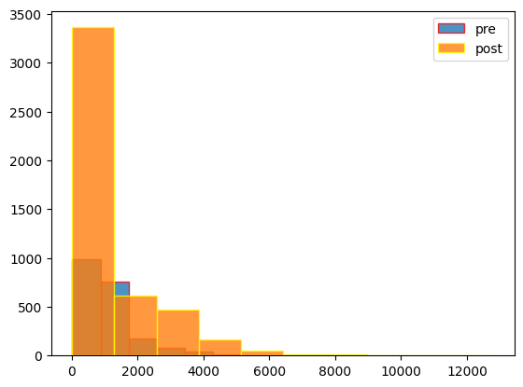
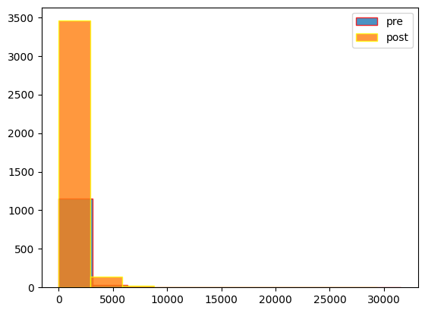
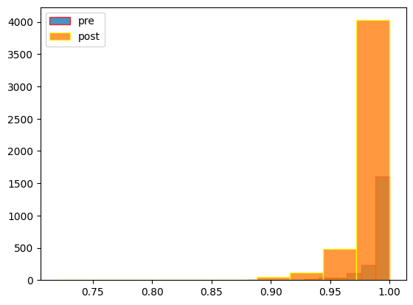
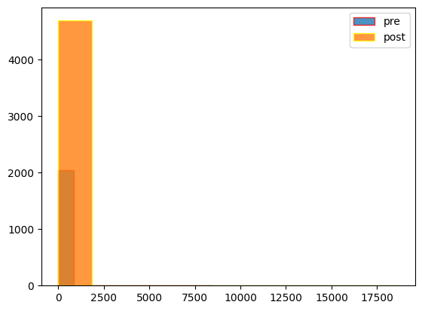
Log Histogram
Post Length
Score
Upvote Ratio
Total Comments

Slide 11
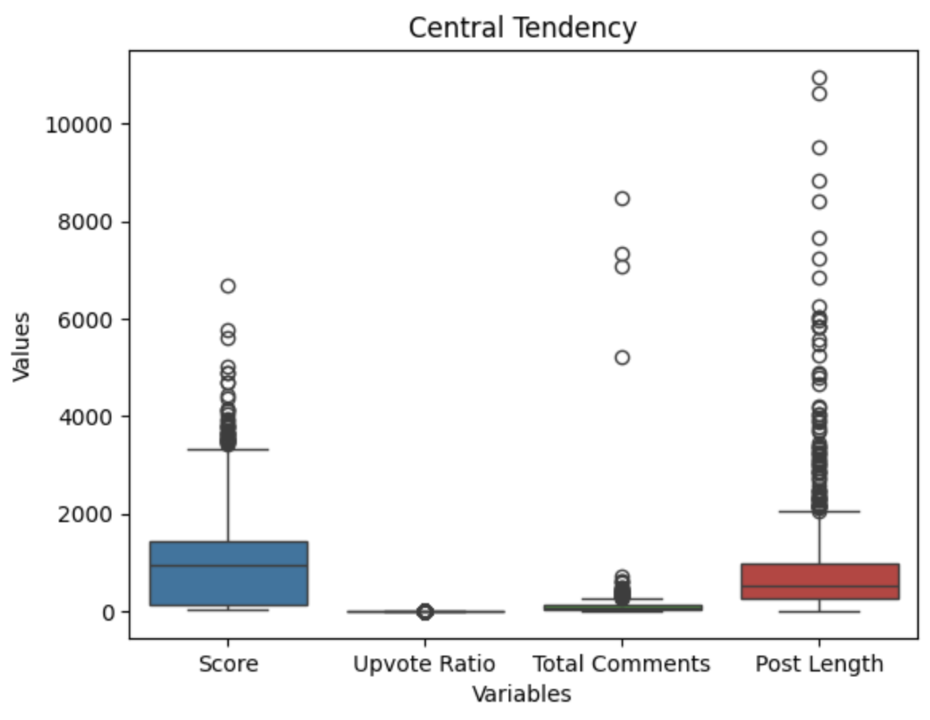
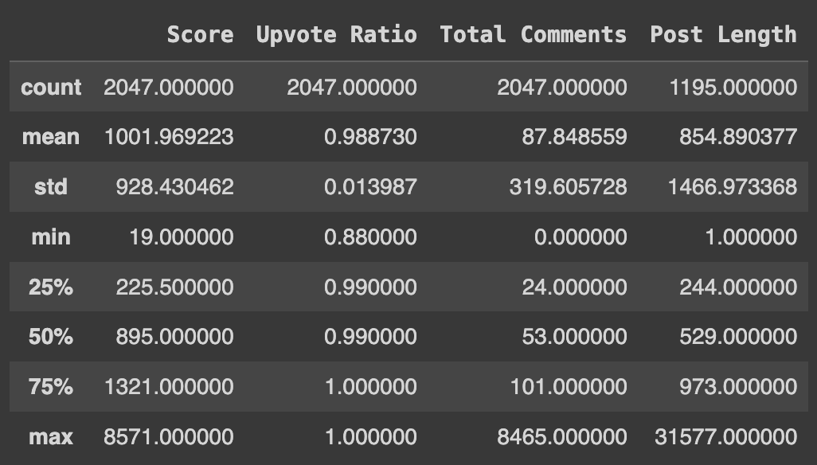
Central Tendency
The central tendency describes the central or typical value around which our datasets tend to cluster.

Slide 12
Text Classification
BERT
Bidirectional transformer pre trained using MLM objective and next sentence prediction on large corpus from Toronto Book Corpus and Wikipedia (110M Parameter)
DistilBERT
Half of BERT layers (66M Parameter), token-type embeddings are removed, dense layer hidden state of token for classification is removed, 60 percent faster than BERT
BERTopic
Techniques that leverages transformers and c-TF-IDF to create dense clusters allowing for easily topics and keeping important words from topic descriptions

Slide 13
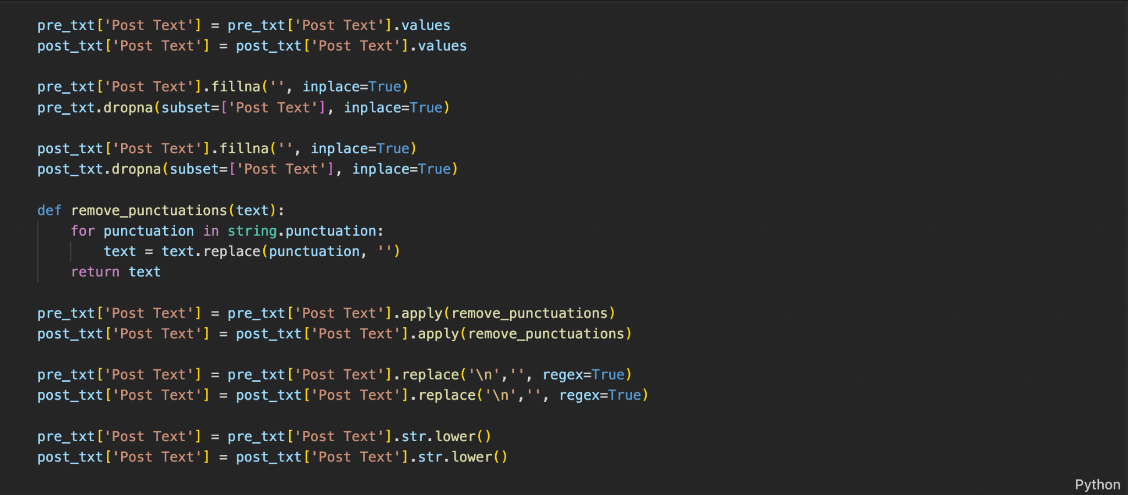
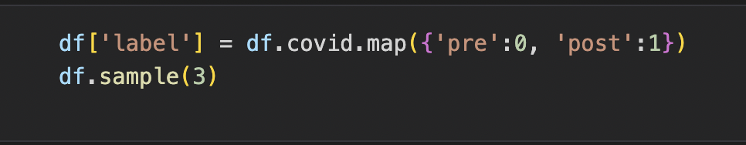
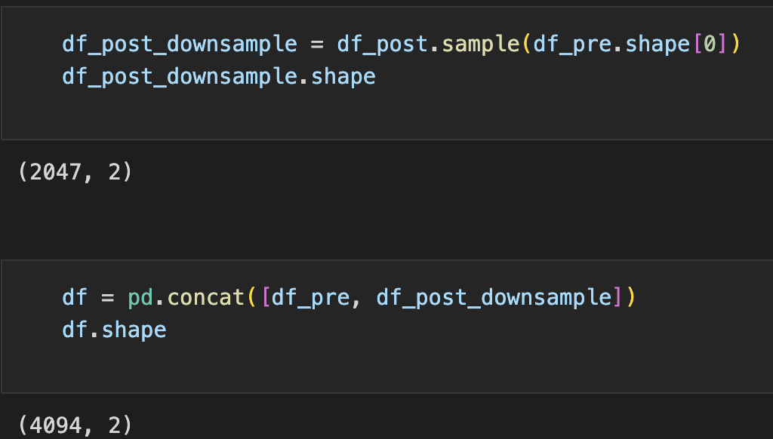
Text Classification
Preprocess for Text Classification
Clean Post Texts to prepare for text classification
Labeling: 0 → pre ; 1 → post
For Binary Classification
Downsampling to balance pre and post 4094 data points

Slide 14
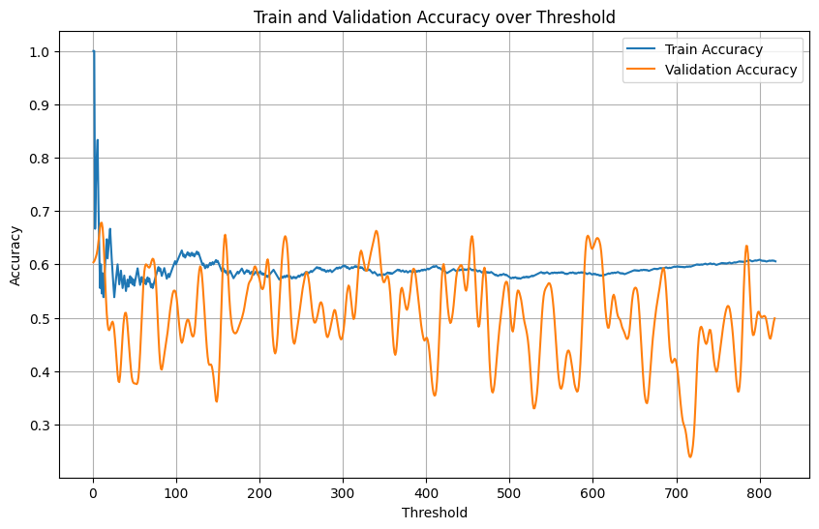
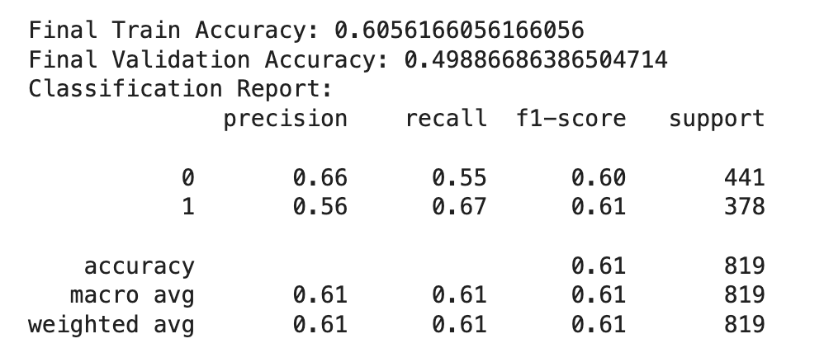
Text Classification - BERT
Num of Epochs/ Batch size | Accuracy | F1-score | Precision | Recall
3/16 | 0.58 | 0.52 | 0.67 | 0.43
6/16 | 0.56 | 0.55 | 0.57 | 0.52
3/15 | 0.60 | 0.59 | 0.65 | 0.54
3/8 | 0.61 | 0.61 | 0.66 | 0.55
Accuracy graph of epochs = 3, batch size = 8

Slide 15
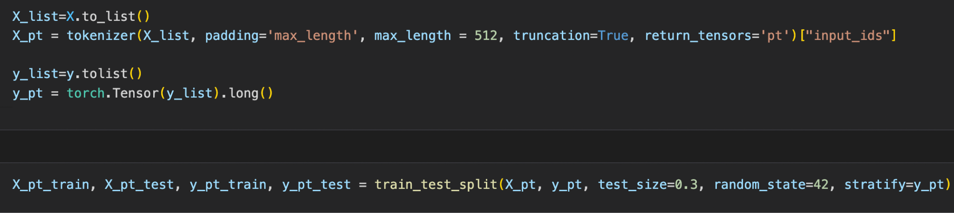
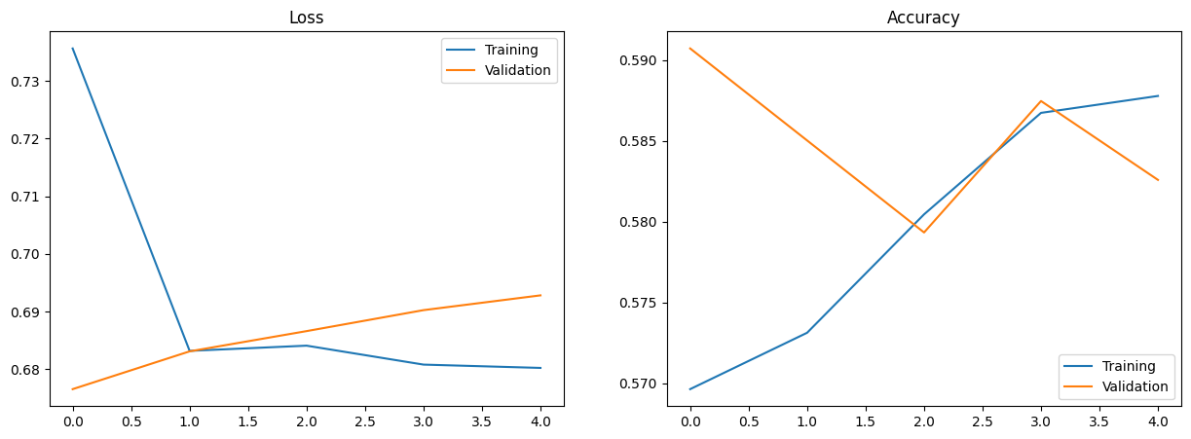
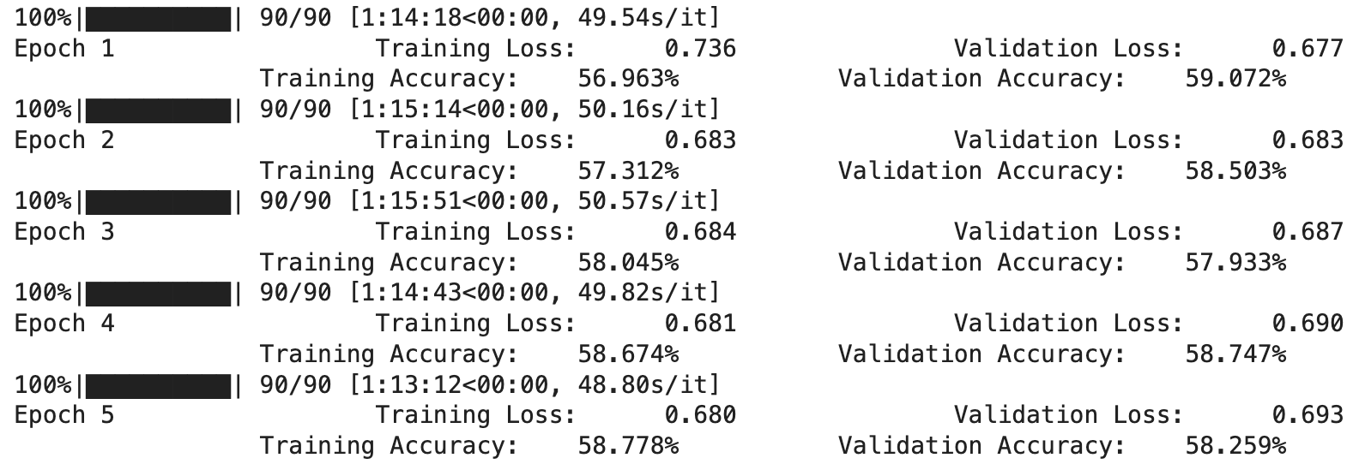
Text Classification - DistilBERT
DistilBERT tokenizer & train and test

Slide 16
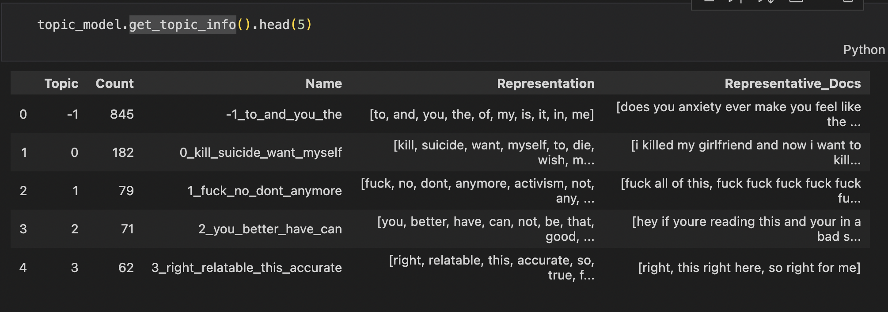
Text Classification - BERTopic
BERTopic model with embedding and sample topic info

Slide 17
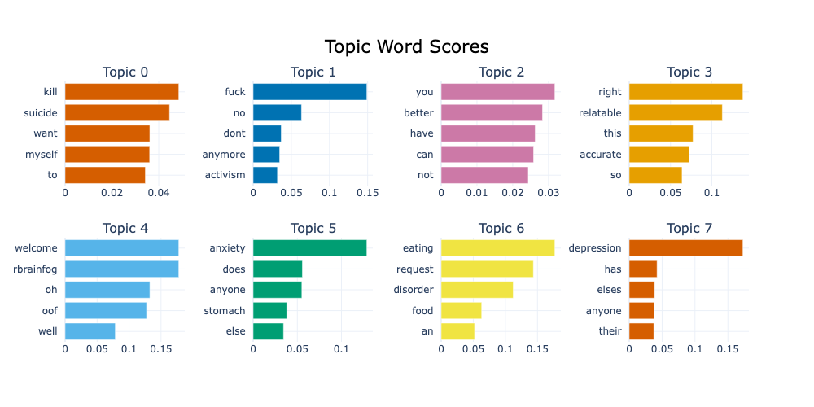
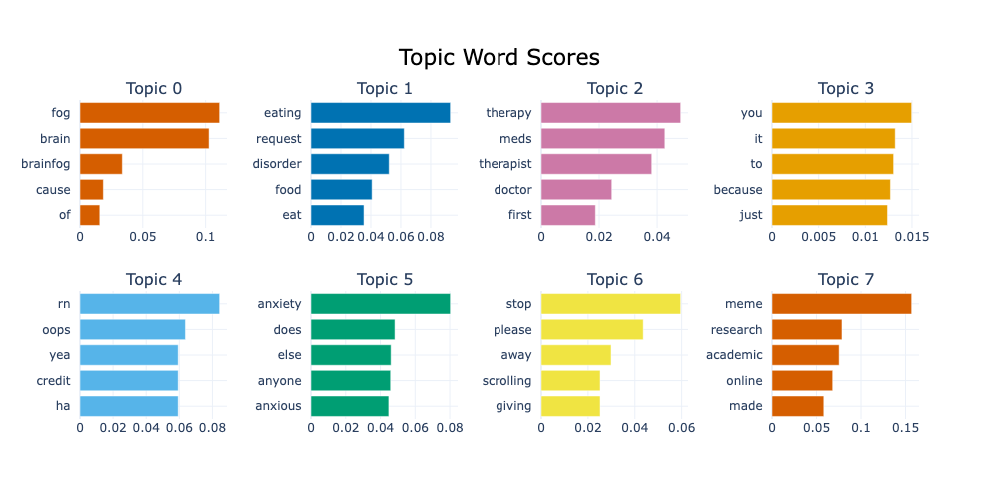
Text Classification - BERTopic
preCOVID Title text result
postCOVID Title text result

Slide 18
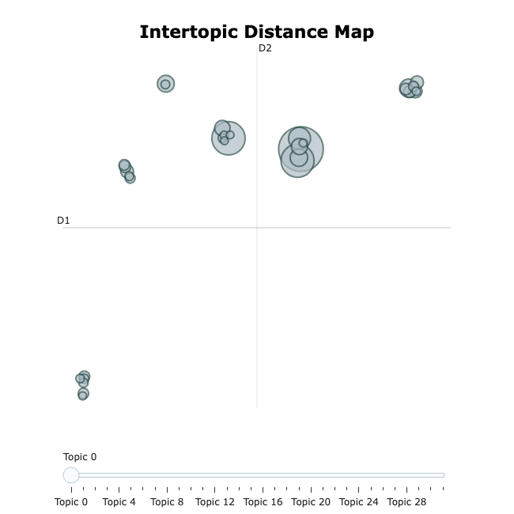
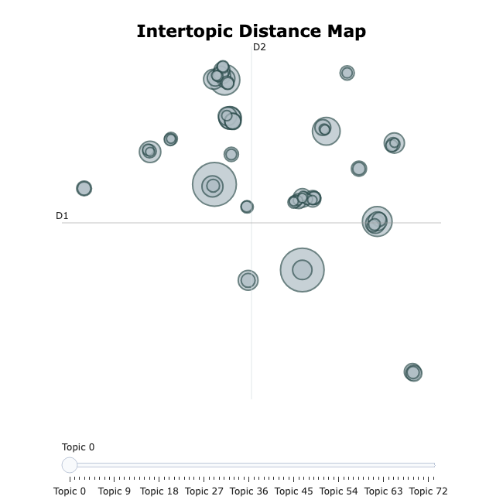
Text Classification - BERTopic
preCOVID Title text result
postCOVID Title text result

Slide 19
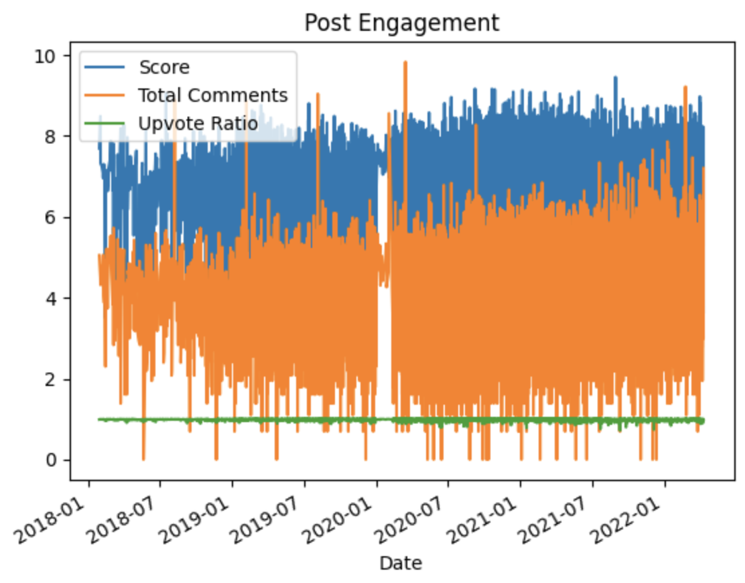
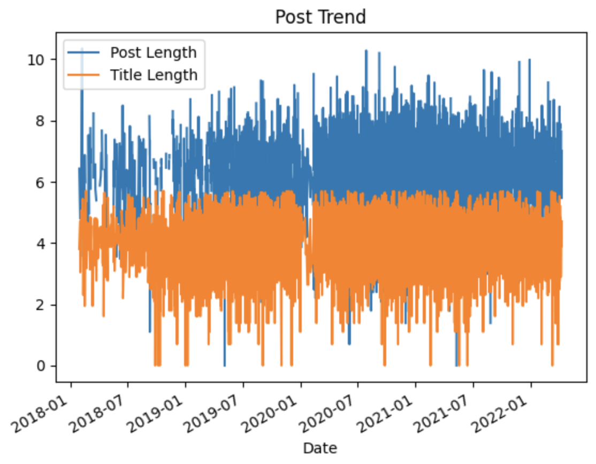
Time Series Analysis

Slide 20
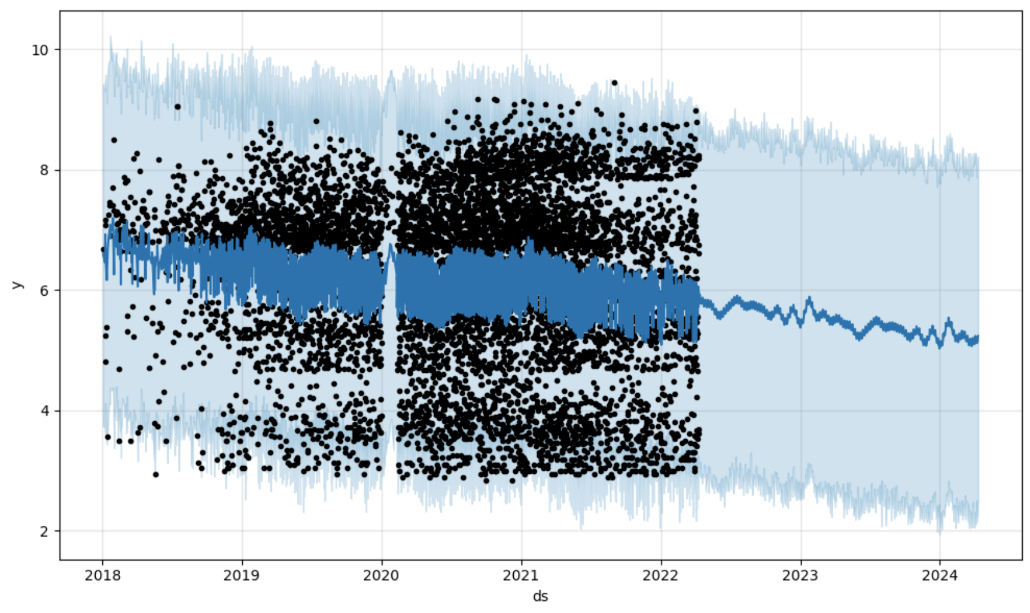
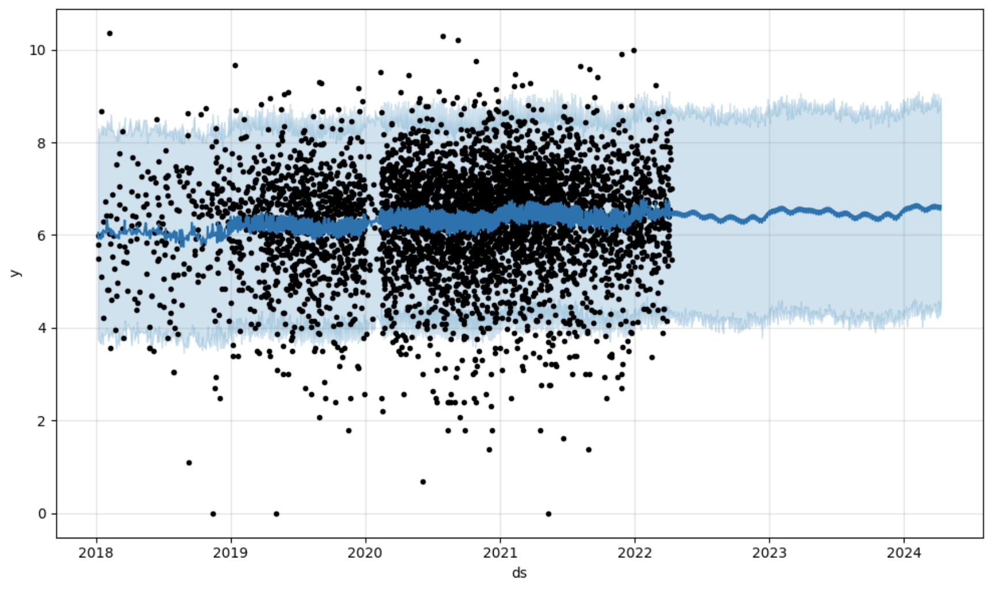
Time Series Analysis
Prophet
Post Engagement: y = Score, regressors = Total Comments, Upvote Ratio
Post Trend: y = Post Length, regressor = Title Length

Slide 21
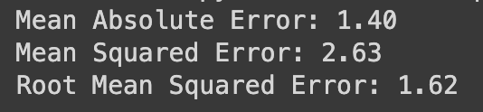
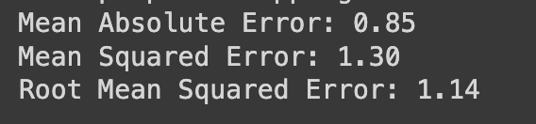
Time Series Analysis
Cross Validation
Post Engagement
Relatively high
-> MAE is robust to outliers since it only considers the absolute differences between the predicted and actual values
-> Data too spread-out, creating large differences between data
The same thing goes for MSE
Post Trend

Slide 22
Conclusion
Post trends before and after COVID
From text classification, we can conclude that there exists a shift between pre and post-COVID. From topic modeling, we also conclude that popular topics are different and post-COVID has a diverse topics than pre-COVID
From time series analysis, post trends increase in the sense that the length of both posts and titles increase
Post engagements before and after COVID
From descriptive analysis, engagement of users increased after COVID
From time series analysis, we can see that post engagement became more robust as more posts show up, but over time it will slowly decrease and stabilize after a year or two

Slide 23
Limitations
Only using one social media platform - Reddit
For text classification, downsampling might drop out important data points
Limited to BERT models, further steps can be approached to GPT
Our time frame is too short to determine overall fundamental differences between pre-COVID and post-COVID

Slide 24

Summary
Check out our medium post!
Research Question/Hypothesis:
Does COVID impact post trends and engagements within mental health-related subreddits?
Mental health-related subreddits will exhibit a shift in post trends and post engagements between the pre-COVID and post-COVID periods
Data Collection: Reddit API with 9 mental health-related subreddits time frame of pre-COVID and post-COVID
Descriptive Analysis: Used Log transformation
Text Classification using PyTorch:
BERT: ~60 percent accuracy with precision of ~0.66 and f1-score of ~0.61
DistilBERT: ~58 percent accuracy but accuracy and loss seems overfitting
BERTopic: Topics are slightly different, but post-COVID has diverse topics
Time Series Analysis:
Post engagement became more robust as more posts showed up, but over time it will slowly decrease and stabilize
Post trend increases in the sense that the length of both posts and titles increase

